Slide 1
CHALLENGES OF MACHINE LEARNING
Main reference:
Chapter 1 of Géron, A. (2019). Hands-on machine learning with Scikit-Learn, Keras, and TensorFlow.

Slide 2
Main tasks in ML:
Select a learning algorithm
Train it on some data
➔ The two things that can cause problems: “bad data” and “bad algorithm.”

Slide 3
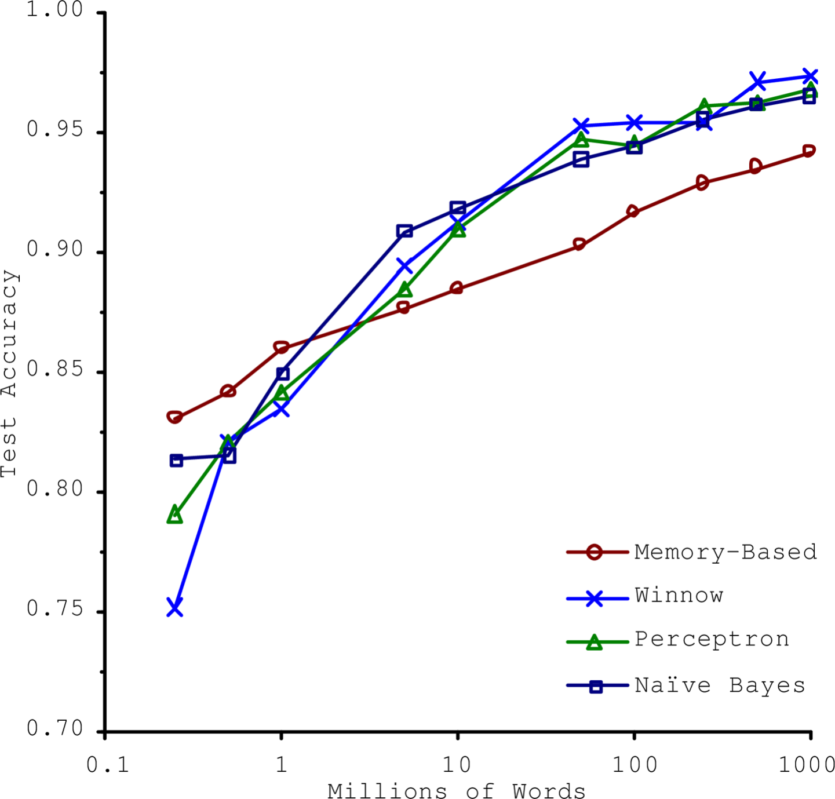
Bad data
1. Insufficient quantity of data:
Banko, M., & Brill, E. (2001). Scaling to very very large corpora for natural language disambiguation.

Slide 4








Bad data
2. Nonrepresentative data:
We need training data that are representative of the new cases.
Two types:

Slide 5
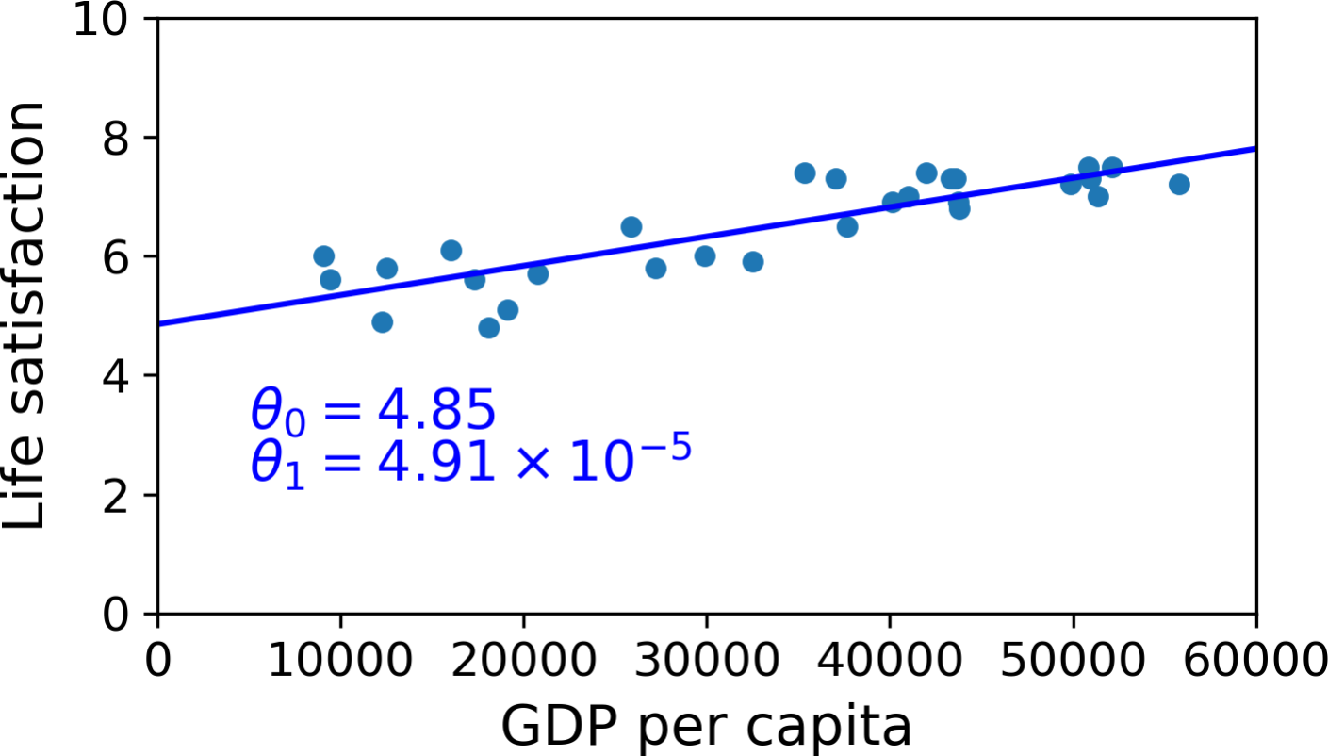
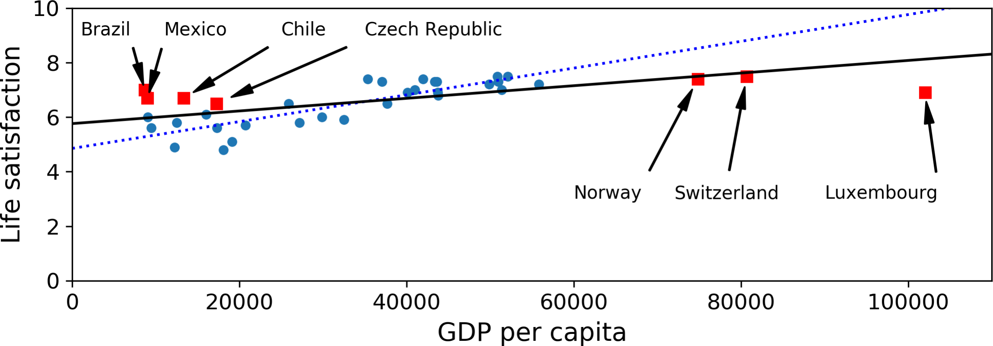



Noisy data
Without noise
With noise
(less accurate)
Source: (Géron, 2019)

Slide 6

Sampling bias
Source: (Géron, 2019)

Slide 7



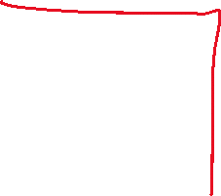
Bad data
3. Missing data:

Slide 8






Bad data
4. Irrelevant features.
Feature selection:
Feature extraction:
Creating new features

Slide 9
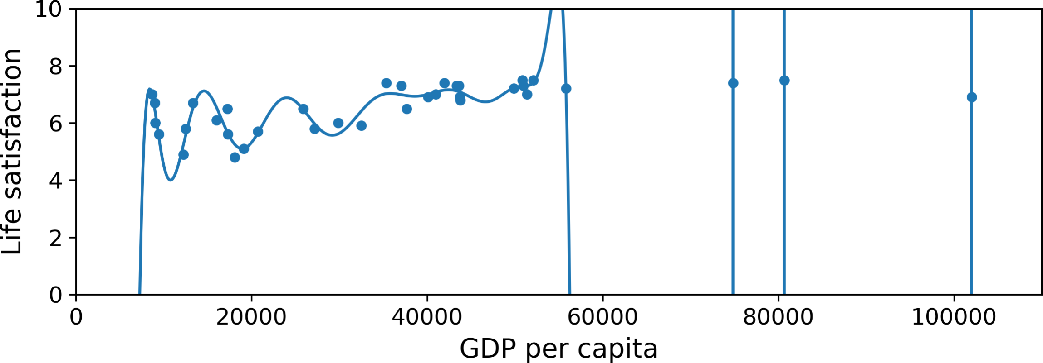





Bad algorithms
1. Overfitting:
Source: (Géron, 2019)

Slide 10
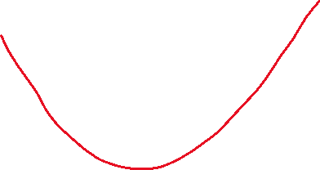






Bad algorithms
2. Underfitting:

Slide 11
TESTING AND HYPERPARAMETER TUNNING

Slide 12








Test set and generalization error

Slide 13
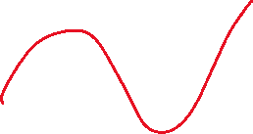



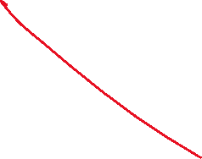






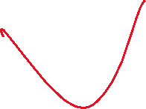
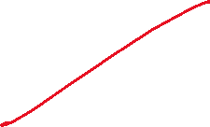


Hyperparameter tuning

Slide 14









Validation set

Slide 15






Validation set
Rule (similar to training set): the validation set and the test must be representative of the data you expect to use in production.
e.g.,

